Slide 1
Hashing
CENG 213 Data Structures

Slide 2
Hash Tables
We’ll discuss the hash table ADT which supports only a subset of the operations allowed by binary search trees.
The implementation of hash tables is called hashing.
Hashing is a technique used for performing insertions, deletions and finds in constant average time (i.e. O(1))
This data structure, however, is not efficient in operations that require any ordering information among the elements, such as findMin, findMax and printing the entire table in sorted order.
CENG 213 Data Structures

Slide 3
General Idea
The ideal hash table structure is merely an array of some fixed size, containing the items.
A stored item needs to have a data member, called key, that will be used in computing the index value for the item.
  Key could be an integer, a string, etc
  e.g. a name or Id that is a part of a large employee structure
The size of the array is TableSize.
The items that are stored in the hash table are indexed by values from 0 to TableSize – 1.
Each key is mapped into some number in the range 0 to TableSize – 1.
The mapping is called a hash function.
CENG 213 Data Structures

Slide 4
Example
Hash
Table
0
1
Items
Hash
Function
2
john 25000
3
john 25000
phil 31250
key
4
phil 31250
dave 27500
5
mary 28200
6
dave 27500
7
mary 28200
key
8
9
CENG 213 Data Structures

Slide 5
Hash function
Problems:
Keys may not be numeric.
Number of possible keys is much larger than the space available in table.
How to decide table size, hash func, hash map code
Different keys may map into same location
  Hash function is not one-to-one => collision.
  If there are too many collisions, the performance of the hash table will suffer dramatically.
CENG 213 Data Structures

Slide 6
Hash Functions
If the input keys are integers then simply Key mod TableSize is a general strategy.
  Unless key happens to have some undesirable properties. (e.g. all keys end in 0 and we use mod 10)
If the keys are strings, hash function needs more care.
  First convert it into a numeric value.
CENG 213 Data Structures

Slide 7
Some methods
Truncation:
  e.g. 123456789 map to a table of 1000 addresses by picking 3 digits of the key.
Folding:
  e.g. 123|456|789: add them and take mod.
Key mod N:
  N is the size of the table, better if it is prime.
Squaring:
  Square the key and then truncate
CENG 213 Data Structures

Slide 8
Hash Function 1
Add up the ASCII values of all characters of the key.
int hash(const string &key, int tableSize)
{
int hasVal = 0;
for (int i = 0; i < key.length(); i++)
hashVal += key[i];
return hashVal % tableSize;
}
Many words have the same sum
if the table size is large, the function does not distribute the keys well.
  e.g. Table size =10000, key length <= 8, the hash function can assume values only between 0 and 1016 (127*8) where 127 is largest integer value for a char.

Slide 9
Hash Function 2
Examine only the first 3 characters of the key.
int hash (const string &key, int tableSize)
{
return (key[0]+27 * key[1] + 729*key[2]) % tableSize;
}
In theory, 26 * 26 * 26 = 17576 different words can be generated. However, English is not random, only 2851 different combinations are possible.
Thus, this function although easily computable, is also not appropriate if the hash table is reasonably large.
CENG 213 Data Structures

Slide 10
Hash function for strings:
98
108
105
key[i]
key
a
l
i
0 1 2
i
KeySize = 3;
hash(“ali”) = (105 * 1 + 108*37 + 98*37²) % 10,007 = 8172
0
hash
function
1
2
“ali”
……
ali
8172
……
10,006 (TableSize)
CENG 213 Data Structures

Slide 11
Hash Code map
Horners Rule with x=33,37,39,41 experimentally found
to give 6 collisions among words in the English dictionary
CENG 213 Data Structures

Slide 12
Compression Code
Examples
H(k)=k mod m
Pick m to be prime to avoid dependency on last few characters
Based on how much load you want to give each cell (k)
in the chain you can nearest prime at n/k
H(k)=m(k A mod 1) for 0<A<1
H(k)= (ak + b) mod m where a and m should be co-prime
Universal Hashing: Pick out of a bunch of hashes at random for one
round of hash table filling.
CENG 213 Data Structures

Slide 13
Collision Resolution
If, when an element is inserted, it hashes to the same value as an already inserted element, then we have a collision and need to resolve it.
There are several methods for dealing with this:
  Separate chaining
  Open addressing
    Linear Probing
    Quadratic Probing
    Double Hashing
CENG 213 Data Structures

Slide 14
Separate Chaining
The idea is to keep a list of all elements that hash to the same value.
  The array elements are pointers to the first nodes of the lists.
  A new item is inserted to the front of the list.
Advantages:
  Better space utilization for large items.
  Simple collision handling: searching linked list.
  Overflow: we can store more items than the hash table size.
  Deletion is quick and easy: deletion from the linked list.
CENG 213 Data Structures

Slide 15
Example
Keys: 0, 1, 4, 9, 16, 25, 36, 49, 64, 81
hash(key) = key % 10.
0
0
1
81
1
2
3
4
64
4
5
25
6
36
16
7
8
9
49
9
CENG 213 Data Structures

Slide 16
Operations
Initialization: all entries are set to NULL
Find:
  locate the cell using hash function.
  sequential search on the linked list in that cell.
Insertion:
  Locate the cell using hash function.
  (If the item does not exist) insert it as the first item in the list.
Deletion:
  Locate the cell using hash function.
  Delete the item from the linked list.
CENG 213 Data Structures

Slide 17
Analysis of Separate Chaining
Collisions are very likely.
  How likely and what is the average length of lists?
Load factor λ definition:
  Ratio of number of elements (N) in a hash table to the hash TableSize.
    i.e. λ = N/TableSize
  The average length of a list is also λ.
  For chaining λ is not bound by 1; it can be > 1.
CENG 213 Data Structures

Slide 18
Hashing: Open Addressing
CENG 213 Data Structures

Slide 19
Collision Resolution with
Open Addressing
Separate chaining has the disadvantage of using linked lists.
  Requires the implementation of a second data structure.
In an open addressing hashing system, all the data go inside the table.
  Thus, a bigger table is needed.
    Generally the load factor should be below 0.5.
  If a collision occurs, alternative cells are tried until an empty cell is found.
CENG 213 Data Structures

Slide 20
Open Addressing
More formally:
  Cells h₀(x), h₁(x), h₂(x), …are tried in succession where h_{i}(x) = (hash(x) + f(i)) mod TableSize, with f(0) = 0.
  The function f is the collision resolution strategy.
There are three common collision resolution strategies:
  Linear Probing
  Quadratic probing
  Double hashing
CENG 213 Data Structures

Slide 21
Linear Probing
In linear probing, collisions are resolved by sequentially scanning an array (with wraparound) until an empty cell is found.
  i.e. f is a linear function of i, typically f(i)= i.
  In other words: Linear probing is when the interval between two successive probes is fixed. Usually at 1. Not necessarily
Example:
  Insert items with keys: 89, 18, 49, 58, 9 into an empty hash table.
  Table size is 10.
  Hash function is hash(x) = x mod 10.
    f(i) = i;
CENG 213 Data Structures

Slide 22
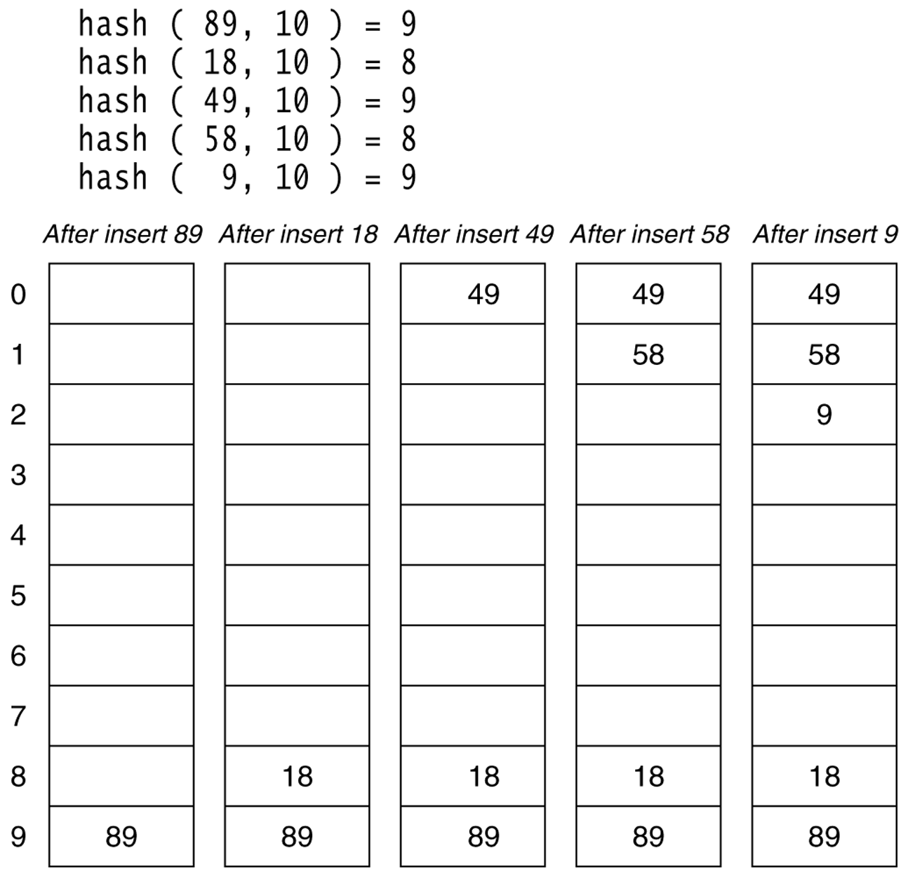
Figure 20.4
Linear probing hash table after each insertion
CENG 213 Data Structures

Slide 23
Find and Delete
The find algorithm follows the same probe sequence as the insert algorithm.
  A find for 58 would involve 4 probes.
  A find for 19 would involve 5 probes.
We must use lazy deletion (i.e. marking items as deleted)
  Standard deletion (i.e. physically removing the item) cannot be performed.
  e.g. remove 89 from hash table.
CENG 213 Data Structures

Slide 24
Clustering Problem
As long as table is big enough, a free cell can always be found, but the time to do so can get quite large.
Worse, even if the table is relatively empty, blocks of occupied cells start forming.
This effect is known as primary clustering.
Any key that hashes into the cluster will require several attempts to resolve the collision, and then it will add to the cluster.
CENG 213 Data Structures

